Slide 1

FIELD TRAINING
How to read a coax hardline print
A night-by-night tutorial: what you were given, where it is, and what to do there.
WHAT YOU GOT
WHERE IT IS
WHAT TO DO
The work that came in tonight
and what you need to pull from it.
How to find that work on the
map — street, then house number.
How to read the notes at that
spot and stay in your scope.
FBR Internal Use Only · Every night and every market is different · Learn the method, not one job

Slide 2
What we are going over
INTERNAL TRAINING
AGENDA
Understand the work you receive each night
Learn the legend and the labels first
01
02
What shows up on your assignment, what you need to take from it, and what you don’t need yet.
Letters, symbols, and numbers on the print — poles, taps, actives, and tags — before you hunt streets.
Open the right map and find the job site
Read the notes at that location
03
04
Match tonight’s work to the correct print, then street, then house number, then the device.
How to use notes and callouts to see what that pole needs — and when to leave it alone.
Do only the work that was assigned
Practice the steps on sample maps
05
06
Jobs change every night and every market. Tonight’s list and the notes decide, not last night’s habit.
We’ll walk example prints so you can run the process. The samples are practice, not “the” job.
FBR · How to read a coax hardline print · Company Confidential
2

Slide 3
Start here: the work-letter legend
INTERNAL TRAINING
LEGEND
Before you look for a street, know what the letters on the print mean. A letter on a device is the work at that spot.
A
E
G
H
J
Swap the active
New tap
New splitter
Add an active
EQ comes out
Replace the amp or node that is already there.
Install a new tap. The number in the circle is the tap value.
Install a new splitter on that branch.
Put in an amp that was not there before.
Remove the equalizer. The print may show a jumper left in.
More than one letter at one spot
If the box says A, E — swap the active and put a new tap there. If it says J and add splice — do both.
Read the whole string. Then check your assignment: if that device is not yours, you still don’t work it.
FBR · How to read a coax hardline print · Company Confidential
3

Slide 4
Start here: symbols on the print
INTERNAL TRAINING
LEGEND
These are the hardware marks you’ll see on the line. Same idea every market — the drawing style can vary a little, the meaning does not.
×
17
Pole
Tap
Active / amp
Node
Circle with an X. Strand plant hangs here. This is a location, not a tap.
Circle with a number. That number is the tap value (dB), not the house and not the pole ID.
Triangle on the line. Powered device. Black corners = input / bridger style — not a splitter. Next slide shows the variants.
Heavier box, often with triangles. Fiber-to-coax point for that area. Not every night is a node swap.
S 14
×
Splitter
Splice
Power
Ped / cabinet
Junction on the line where one hardline becomes two. Work letter G if it’s new.
Box or mark with S (sometimes S 14). Hardline is joined here. Notes may say add / resplice.
Supply or inserter. You may see 90V, amps, or a bolt. Only your job if it was assigned.
Square or box on the ground path. Buried plant, not a pole. Same idea: find the address first.
FBR · How to read a coax hardline print · Company Confidential
4

Slide 5
Triangles and circles — what they actually are
INTERNAL TRAINING
LEGEND
Triangle + black corners
Open / regular triangle
Filled / solid circle
Empty circle
AMPLIFIER (active). The filled corners mark the output legs. Bridger / mini-bridger style. Not a splitter.
AMPLIFIER too — usually a line extender (one output). Same family as the black-corner triangle.
TERMINATOR. Caps a dead-end or unused port. Notes may say ADD TERM.
Often just a pole or a simple junction. Don’t treat it as a tap unless it has a value in it.
+
x
2
Circle with + or ×
Half-filled circle + x
Circle with a small number
Splitter (for comparison)
POLE. Strand plant hangs here. The address is still the gray number in the lot.
POWER at that device — power passing or a power inserter. Only your job if it was assigned.
If it’s 4, 8, 11, 14, 17, 20, 23, 26 — that’s TAP VALUE. A 1–4 next to a house is how many drops, not the tap.
A splitter is a junction that splits the hardline. Work letter G. It is passive with no gain different from a dual output
FBR · How to read a coax hardline print · Company Confidential
5

Slide 6
Start here: lines and marks on the print
INTERNAL TRAINING
LEGEND
The linework tells you how plant is built. The marks next to it tell you where you are and what work is called.
142'
176
Hardline
Drop / service
Footage
House number
Thick solid line along the street. This is the coax you splice — not the drop to the house.
Thinner line or tick toward a lot. That’s the house feed, not the mainline.
Number with a foot mark (142'). Distance to the next device. Not the address.
Gray number sitting in the lot. Street + this number is where you park.
A6
E
NOTE
Device ID
Work letter
Note / callout
Node boundary
Small tag like A6 or E12. Match it to tonight’s assignment. This is the name, not the work.
Letter box on a device (A, E, G…). That’s the work at that spot — if it’s on your list.
Text with an arrow. Read it before you open anything. It can say stop, splice, or leave it.
Heavy colored line. Work stops here unless that node is on tonight’s assignment.
FBR · How to read a coax hardline print · Company Confidential
6

Slide 7
Start here: the labels on the map
INTERNAL TRAINING
LEGEND
Four kinds of numbers sit next to each other. Learn this before you hunt a job site. Only one of them is the address.
176
176'
17
A6
GRAY NUMBER IN THE LOT
NUMBER WITH A FOOT MARK
NUMBER INSIDE A CIRCLE
SMALL TAG BY A DEVICE
HOUSE / ADDRESS
FOOTAGE
TAP VALUE
DEVICE ID
This is where you park. Street + this number is the job site.
How far along the line to the next device. Not the house.
The tap at that spot, if that tap is yours. Not the address.
The name of that amp or tap. Match it to tonight’s assignment.
FBR · How to read a coax hardline print · Company Confidential
7

Slide 8
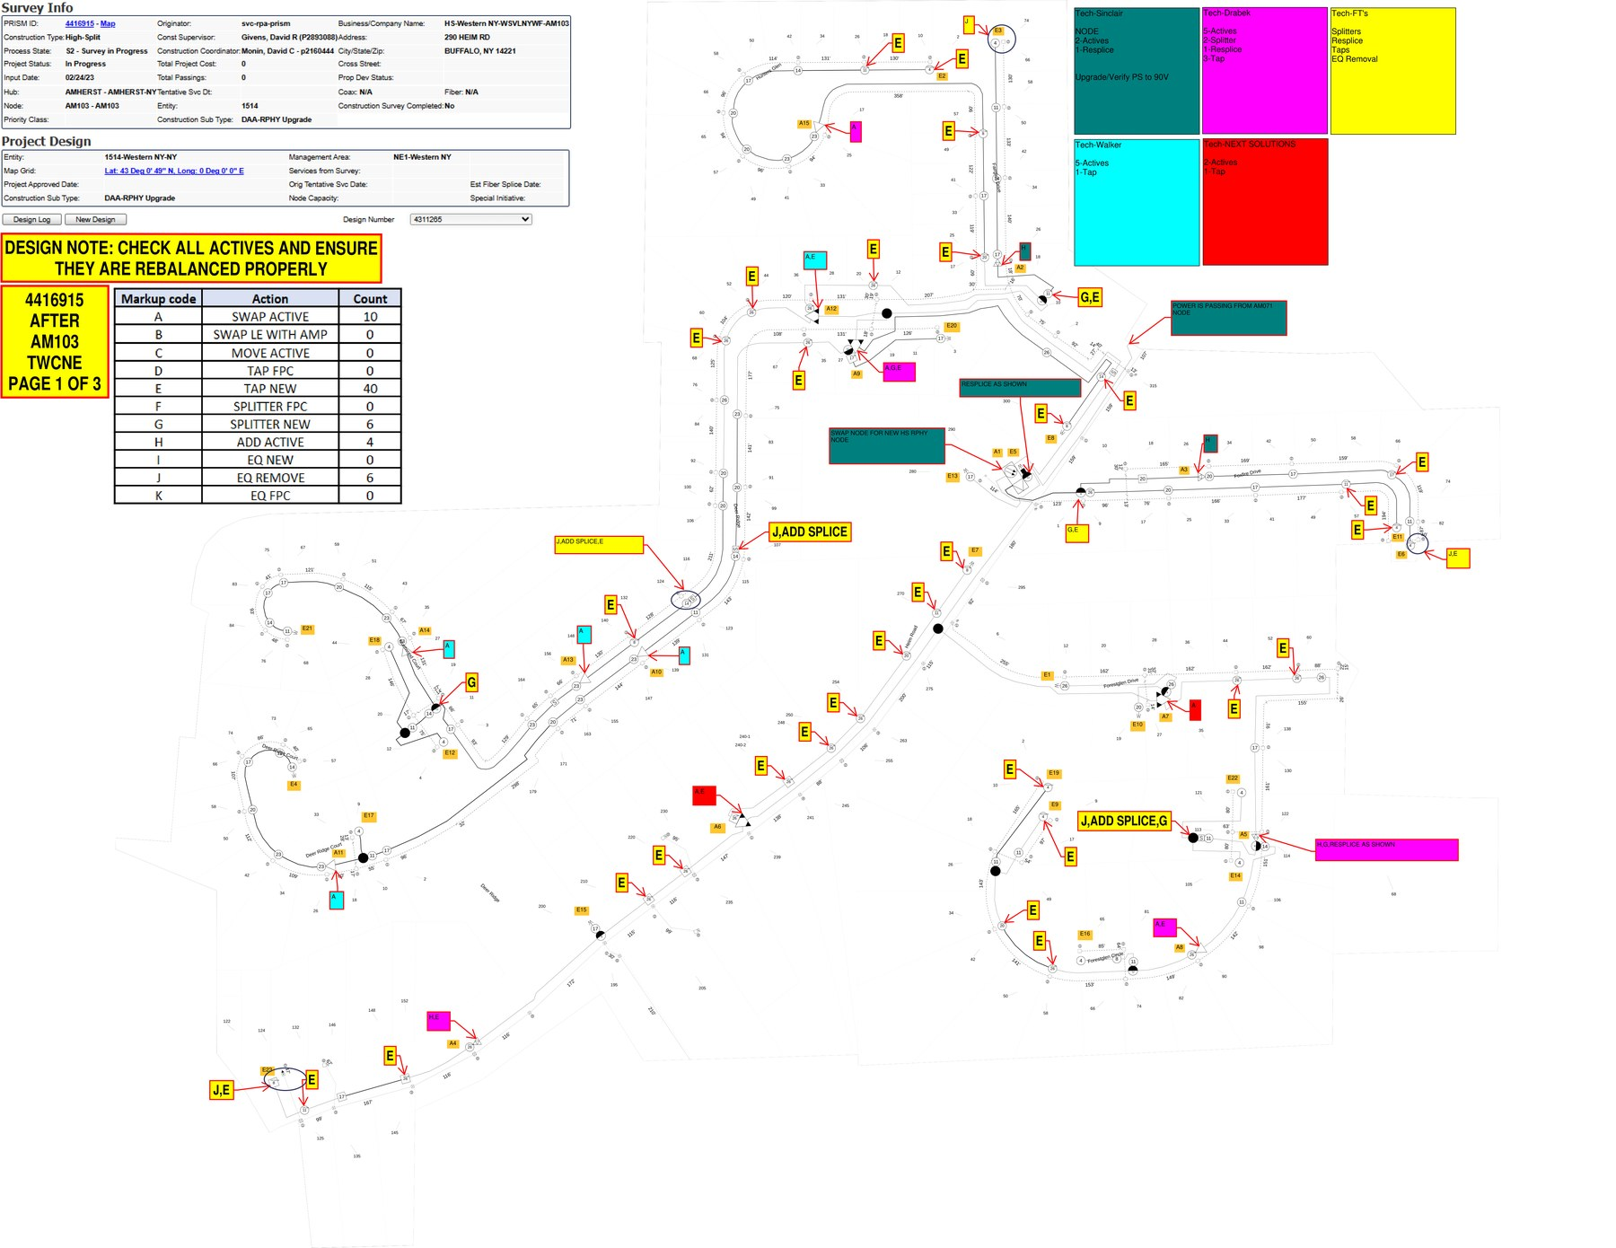
What a print looks like — add your arrows here
INTERNAL TRAINING
THE MAP
Use this slide for overlays
Point arrows at:
• Pole (circle + X)
• Street name
• House / lot number
• Tap (circle + value)
• Amp / node
• Splice / splitter
• Work letter + note
This is a sample print. Tomorrow’s map will be a different node and a different town.
FBR · How to read a coax hardline print · Company Confidential
8

Slide 9
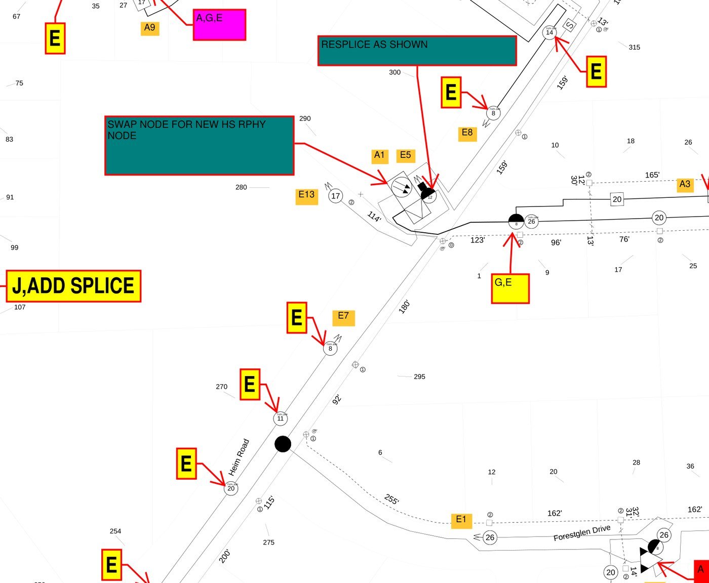
A closer look — street, lot, device, note
INTERNAL TRAINING
THE MAP
Label this close-up
Good overlay order:
1. Street
2. House number
3. The device on that lot
4. The work letter
5. The note pointing at it
If you can mark those five things on any print, you can find the job.
FBR · How to read a coax hardline print · Company Confidential
9

Slide 10
Understand the work you receive each night
INTERNAL TRAINING
TUTORIAL
You do not need the whole print yet. You need tonight’s list. That list changes. The way you read it does not.
What to take from the assignment
What you can ignore for now
Node or area name, the device IDs that are yours, and the count (how many actives, taps, splices). Write them down before you open the map.
Other people’s names, other crews’ counts, and any extra columns that don’t help you find a street. Come back to those only if a lead adds scope.
What will be different tomorrow
How you know you’re ready to open the map
The node, the town, the hardware, even the filename. Don’t memorize one sample job. Memorize: list → right map → address → notes.
You can say out loud: “I have these device IDs on this node.” If you can’t, you’re not ready to hunt streets.
FBR · How to read a coax hardline print · Company Confidential
10

Slide 11
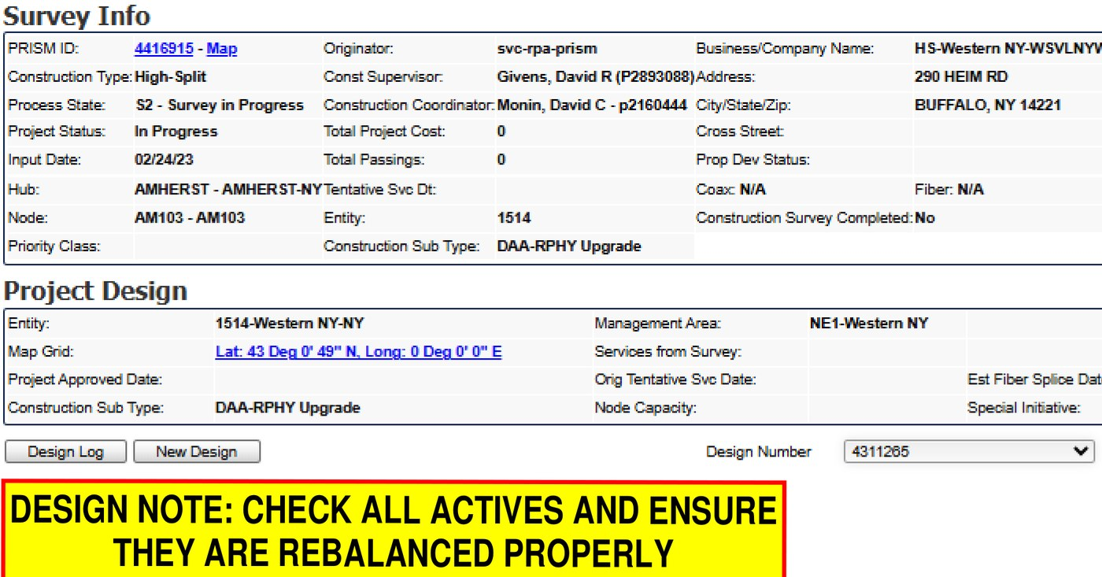
Open the right map for that work
INTERNAL TRAINING
TUTORIAL
Check these before you hunt
1. The node / area on the print matches tonight’s assignment.
2. You’re in the right town / hub — street names should look familiar for where you were sent.
3. Find the box with your company or name. That box is your count for this print.
4. If the node doesn’t match the sheet, you have the wrong file. Close it.
Filenames vary by market. Don’t rely on the name alone — confirm the node on the print.
FBR · How to read a coax hardline print · Company Confidential
11

Slide 12
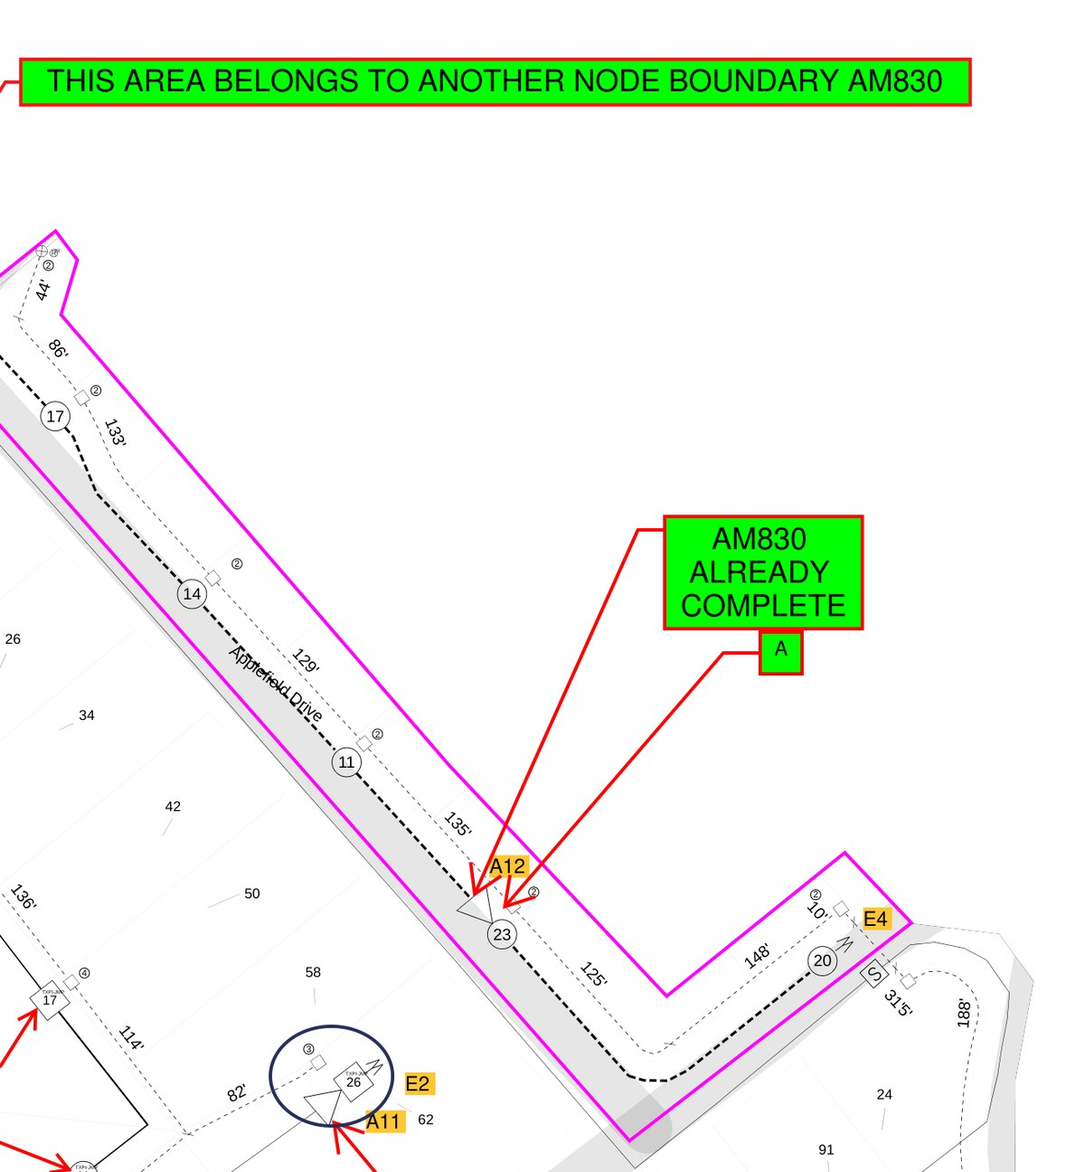
Find the job site: street, then house number, then the device
INTERNAL TRAINING
TUTORIAL
The order
1. Street name — that’s how you stage the truck.
2. Gray number in the lot — that’s the address. Park here.
3. Device on that lot — amp, tap, splitter.
4. Device tag — does it match an ID on tonight’s list?
If the street is wrong, stop. Don’t “fix it” by working the next block over.
Add arrows on this map for street and house numbers.
FBR · How to read a coax hardline print · Company Confidential
12

Slide 13
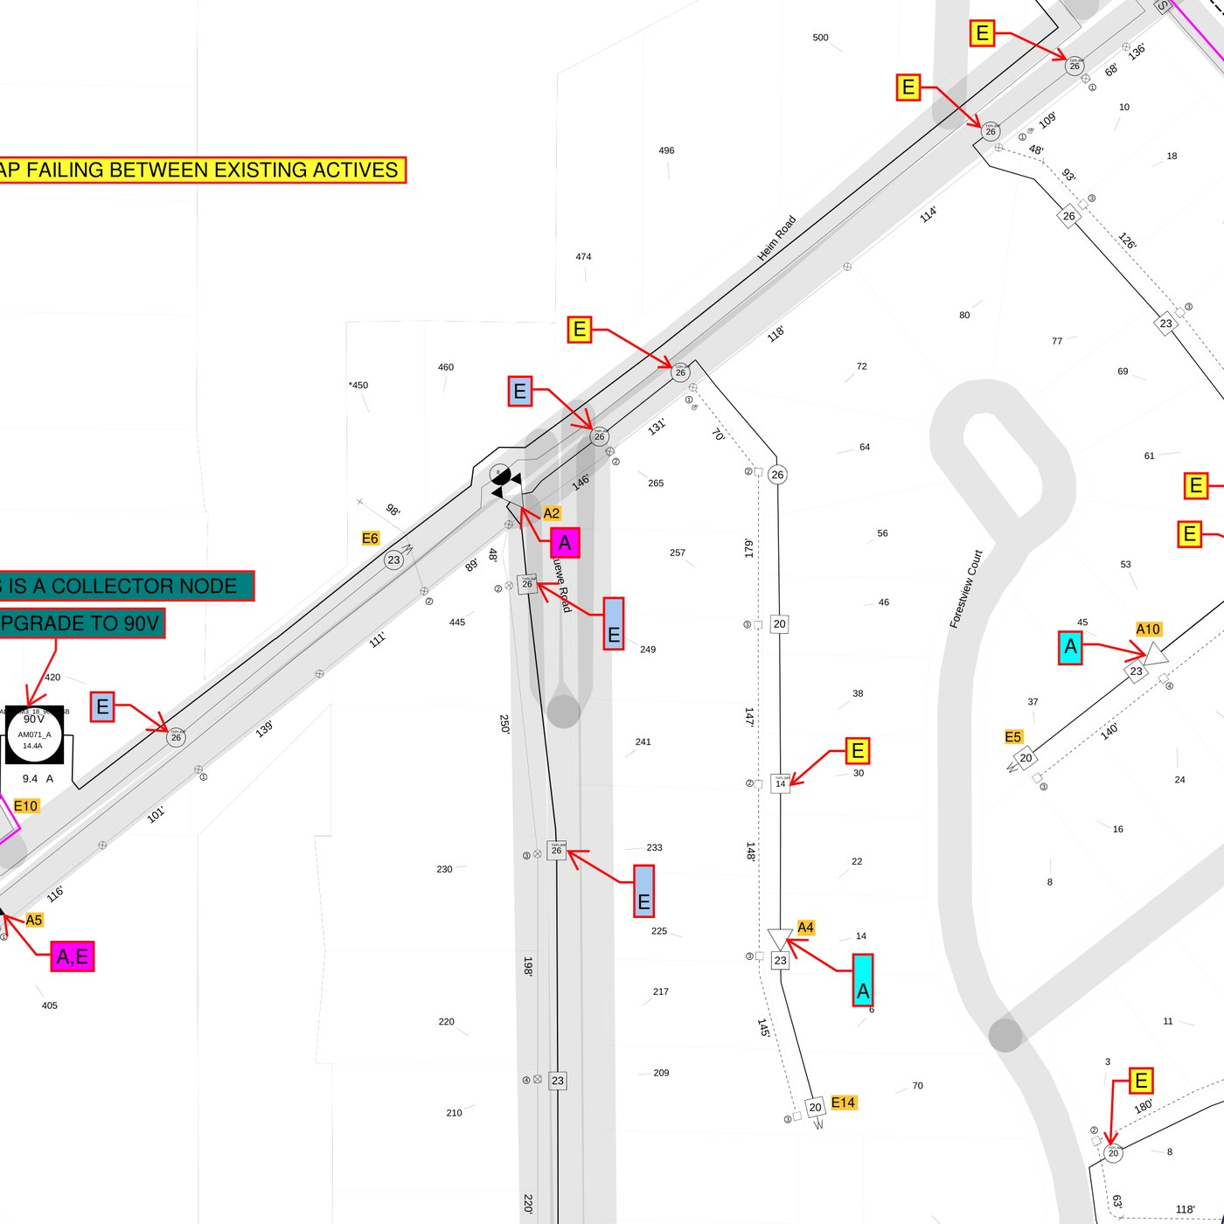
Same method on a different sample print
INTERNAL TRAINING
TUTORIAL
Practice overlay
Pick one assigned device on this sample and mark:
• The street
• The house number
• The device
• Whether it’s on tonight’s list
If you can’t find the house number, you’re not ready to climb.
FBR · How to read a coax hardline print · Company Confidential
13

Slide 14
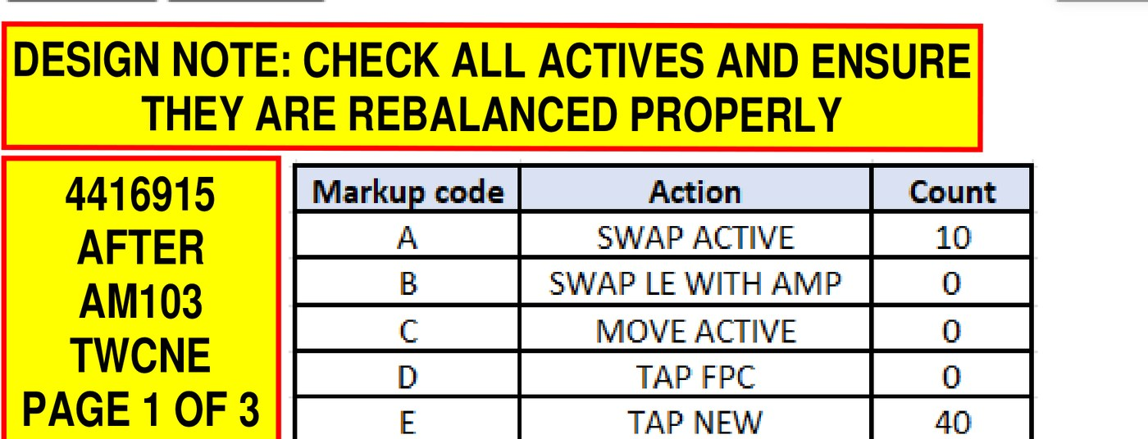
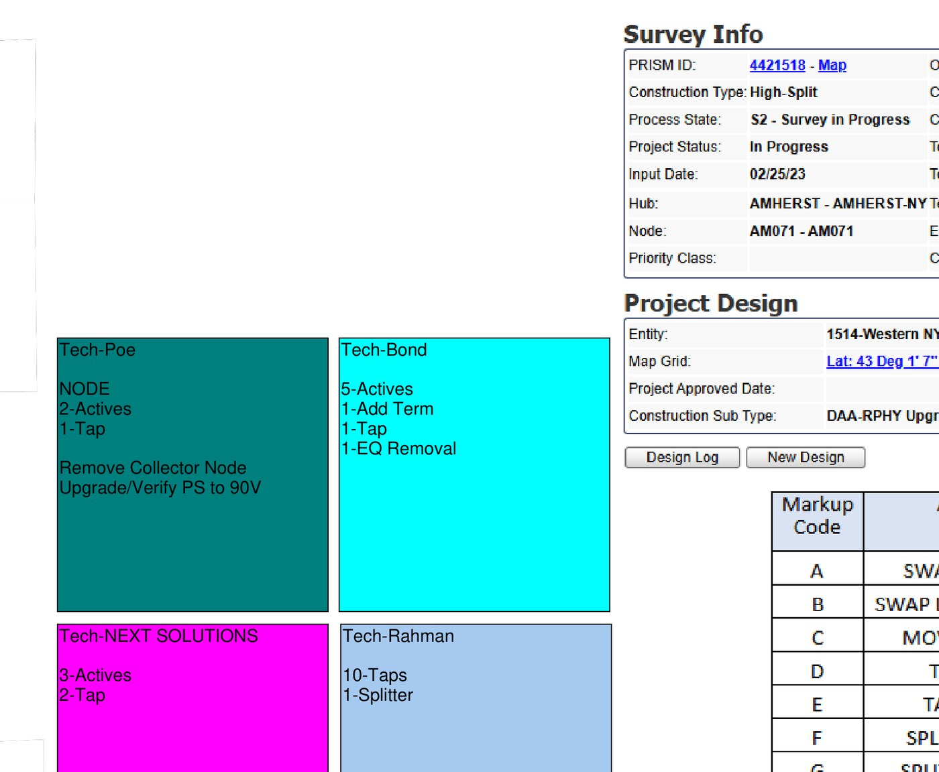
Read the notes at that location before you work
INTERNAL TRAINING
TUTORIAL
What notes are for
A note on the print beats a guess.
Common ones you’ll see:
• Work at this pole (splice, term, swap)
• This area is another node — leave it
• Already complete — don’t reopen it
• Power / plant-wide instruction
Read the print-wide note first, then the arrows at your devices.
If a note and your assignment disagree, stop and ask. Don’t invent scope.
FBR · How to read a coax hardline print · Company Confidential
14

Slide 15
Do only the work that was assigned
INTERNAL TRAINING
TUTORIAL
Tonight’s job
Not automatically yours
1. You’re on the right street and house number.
2. The device tag matches an ID on your list.
3. You read the notes pointing at that device.
4. You do the work listed for you at that spot.
5. On AOI high-split actives, let it auto-balance unless that job or a lead says otherwise.
6. Close it out. Don’t add extra plant because you were already there.
Node swaps, power upgrades, a street full of taps, splices, EQ removals — only if they’re on your list or a lead adds them.
Last night may have been a mini-bridger. Tonight may be taps, a splice, or a different market’s hardware.
The method stays the same. The work does not.
FBR · How to read a coax hardline print · Company Confidential
15

Slide 16
The order — every night, every market
INTERNAL TRAINING
TUTORIAL
1
Read tonight’s assignment
2
Open the matching print
3
Use the legend
Write the node and the device IDs that are yours.
Confirm the node on the print matches the sheet.
Know the letters and which number is the address.
4
Find the job site
5
Read the notes
6
Do assigned work
Street, then house number, then the device on that lot.
Print-wide note, then the callouts at your devices.
Only what’s on your list. Auto-balance when that’s the job.
FBR · How to read a coax hardline print · Company Confidential
16

Slide 17
Practice: find assigned work on this sample
INTERNAL TRAINING
PRACTICE
Review the Network Evolution Excel Sheet
This sheet will contain a list of all the assigned techs for that nights work and what work they were issued.
1. Format : NODE-AMPID (SOME MAY CONTAIN AN UNDERSCORE)
2. You will take this ID and go to the map (AFTER PRINT) to find the Tag #
3. Use the Tag # to find the location on the map and find the closest address.
4. Enter the address in your work phone maps and head there!
FBR · How to read a coax hardline print · Company Confidential
17

Slide 18
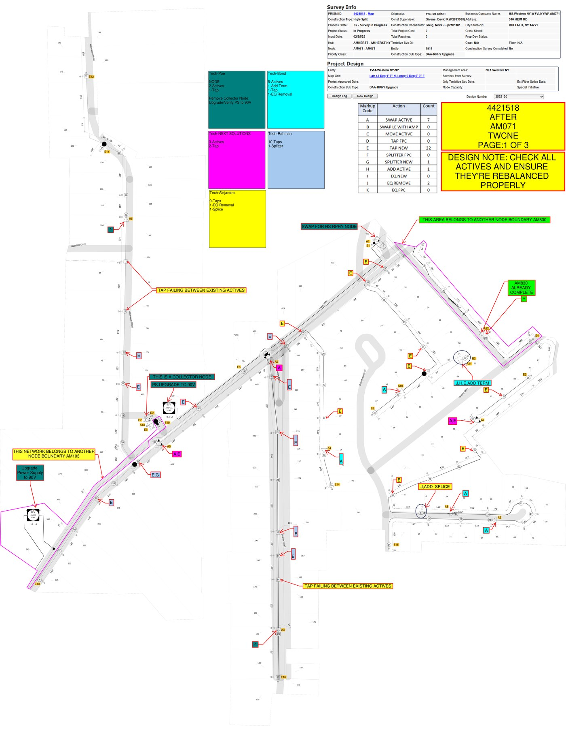
Practice: same steps, different sample
INTERNAL TRAINING
PRACTICE
What to mark
This sample has a different layout, different streets, and work that belongs to more than one crew.
Mark:
• A node boundary / “leave it” note
• One assigned device and its house number
• One note that is not your work
If you can tell “mine” from “not mine” on a busy print, you’re reading it right.
FBR · How to read a coax hardline print · Company Confidential
18

Slide 19
Where people get it wrong
INTERNAL TRAINING
TUTORIAL
Starting in the middle of the map
Wrong print
Open the assignment first. If you don’t know tonight’s IDs, the streets won’t help you.
The file on the tablet isn’t automatically tonight’s node. Confirm the node on the print matches the sheet.
Treating a tap value as an address
Working another crew’s devices
The circle is not the house. The gray number in the lot is where you park.
A print can be covered in work letters. Yours are the ones on your list.
Ignoring a leave-it note
Assuming last night’s setup
Another node, already complete, or past a boundary — don’t reopen it.
Not every job is the same amp or the same market. Read this job. Auto-balance when that’s what you were given.
FBR · How to read a coax hardline print · Company Confidential
19

Slide 20
Quick reference
INTERNAL TRAINING
KEEP THIS SLIDE
1
Assignment
2
Right map
3
Legend
4
Address
5
Notes
6
Work
Circle with an X
Circle with a number
Triangle / heavy box
Pole — strand location
Tap value — not the house
Active or node
S 14 / junction
Gray number in the lot
Letter box + note
Splice or splitter
Address — park here
Work at that spot, if it’s yours
DO
DON’T
Take tonight’s IDs off the assignment first.
Confirm the node on the print.
Park on the house number.
Read notes at that pole.
Do only what’s on your list.
Start in the middle of the streets.
Treat a circle as an address.
Work another crew’s letters.
Assume last night’s hardware or setup.
Guess when the sheet and print don’t match.
FBR · How to read a coax hardline print · Company Confidential
20

Slide 21
Check that you can do this
INTERNAL TRAINING
PRACTICE
1. You just got tonight’s assignment. What do you write down before you open a map?
2. You’re on a lot labeled 23. Next to it is a circle with 23. Where do you park, and what is the circle?
3. Your list is two actives. The print is covered in work letters. Which devices do you work?
4. A note says this area belongs to another node, or is already complete. What do you do?
5. Last night was a mini-bridger. Tonight’s list is taps in a different market. What stays the same?
6. The print on the tablet doesn’t match the node on your sheet. What’s the next step?
Answers on the next slide. If two or more are shaky, run a sample print with a supervisor before you take a truck.
FBR · How to read a coax hardline print · Company Confidential
21

Slide 22
Check — answers
INTERNAL TRAINING
PRACTICE
The node / area and the device IDs that are yours — plus the count. That’s the target list.
1
Park at house 23. The circle is the tap value, not the address.
2
Only the devices on your list. The rest of the letters belong to other crews or other nights.
3
Leave it. Don’t reopen finished plant and don’t work another node.
4
The method: assignment → right map → legend → address → notes → assigned work. The hardware can change.
5
Wrong file. Close it and open the print that matches tonight’s node. Don’t start from the streets.
6
FBR · How to read a coax hardline print · Company Confidential
22

Slide 23
YOU’RE READY WHEN YOU CAN DO THIS ON ANY PRINT
Know tonight’s work. Find the address. Do that job.
Write the IDs, open the matching map, use the legend, park on the house number,
read the notes, and stay in your scope. Tomorrow will be a different night.
Tonight’s IDs are written down
The print matches that node
Parked on the house number
Notes read — only assigned work done
FBR · Internal training · If the sheet and the print don’t agree, stop and call a supervisor

